Slide 1


ENGR 1111 Intro to Engineering: Civil Engineering Fall 2022 Part 9: Sustainability and Green Development

Slide 2

Part 9: Sustainability and Green Development
Sustainability – meeting our own needs without compromising the ability of future generations to meet their own needs

Slide 3
Part 9: Sustainability and Green Development
The American Society of Civil Engineers has sustainability as part of their Code of Ethics.
Engineers govern their professional careers on the following fundamental principles:
create safe, resilient, and sustainable infrastructure;
treat all persons with respect, dignity, and fairness in a manner that fosters equitable participation without regard to personal identity;
consider the current and anticipated needs of society; and
utilize their knowledge and skills to enhance the quality of life for humanity.

Slide 4
Part 9: Sustainability and Green Development
Sustainable Development defined by ASCE:
Sustainable development is the challenge of meeting human needs for natural resources, industrial products, energy, food, transportation, shelter, and effective waste management while conserving and protecting environmental quality and the natural resource base essential for future development

Slide 5
Part 9: Sustainability and Green Development
United Nations and the 17 Sustainable Development Goals (https://sdgs.un.org/goals#history)
History:
The 2030 Agenda for Sustainable Development, adopted by all United Nations Member States in 2015, provides a shared blueprint for peace and prosperity for people and the planet, now and into the future. At its heart are the 17 Sustainable Development Goals (SDGs), which are an urgent call for action by all countries - developed and developing - in a global partnership. They recognize that ending poverty and other deprivations must go hand-in-hand with strategies that improve health and education, reduce inequality, and spur economic growth – all while tackling climate change and working to preserve our oceans and forests.

Slide 6
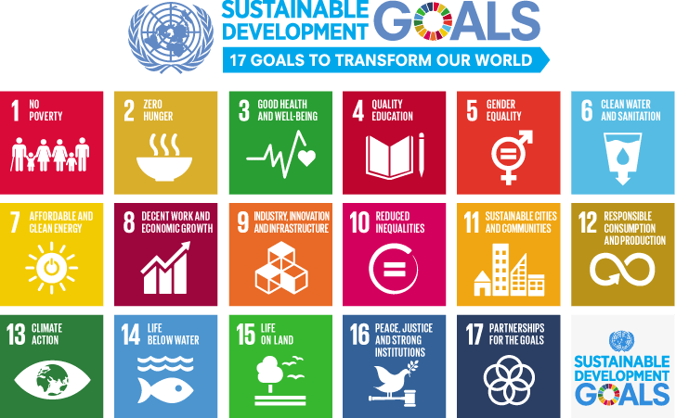
Part 9: Sustainability and Green Development

Slide 7

Part 9: Sustainability and Green Development
Green Engineering
The United States Environmental Protection Agency defines green engineering as “the design, commercialization, and use of processes and products that minimize pollution, promote sustainability, and protect human health without sacrificing economic viability and efficiency”

Slide 8
Part 9: Sustainability and Green Development
EPA’s Principles of Green Engineering
Holistically use systems analysis and integrate environmental impact assessment tools.
Conserve and improve natural ecosystems while protecting human health and well-being.
Use life-cycle thinking in all engineering activities.
Ensure that all material and energy inputs and outputs are as inherently safe and benign as possible.
Minimize depletion of natural resources.

Slide 9

Part 9: Sustainability and Green Development
EPA’s Principles of Green Engineering (continued)
Strive to prevent waste.
Develops and applies engineering solutions while being cognizant of local geography, aspirations, and cultures.
Creates engineering solutions beyond current or dominant technologies; improves, innovates, and invents (technologies) to achieve sustainability.
Actively engages communities and stakeholders in the development of engineering solutions.

Slide 10
Part 9: Sustainability and Green Development
Materials Selection
Engineers decide what materials to use when designing equipment, machines, roads, bridges, airplanes…
General factors to consider:
Strength
Stiffness
Density
Corrosion resistance
Cost
What about Environmental Impact??

Slide 11
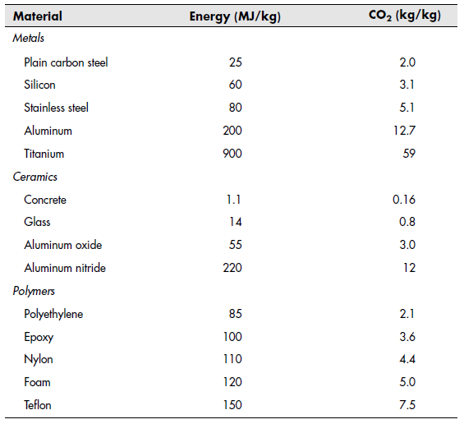
Part 9: Sustainability and Green Development

Slide 12
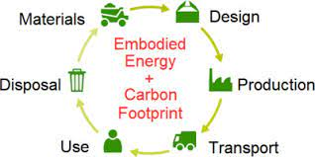
Part 9: Sustainability and Green Development
Materials Selection
It is commonly assumed that the pollution caused by particles and gasses emitted during production of a material is proportional to the energy consumption – this is not always accurate

Slide 13
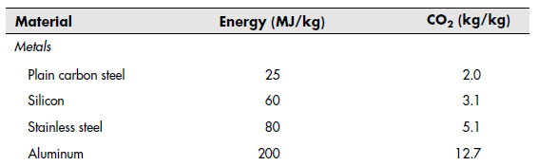
Part 9: Sustainability and Green Development
Materials Selection
Note the difference between steel and aluminum
Aluminum requires more energy due to the process required to reduce alumina ore to aluminum metal requires a lot of electricity
What if recycled aluminum was utilized?

Slide 14
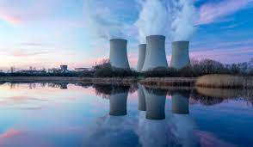
Part 9: Sustainability and Green Development
Nuclear Energy
Nuclear Physics deals with transformations in the nucleus of atoms
Green engineering comes into play if nuclear reactors are to be used to offset the reduction of coal-fired power plants
Disadvantages:
High costs to build reactors and auxiliary systems
Concerns over high-level radioactive wastes

Slide 15
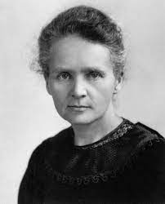
Part 9: Sustainability and Green Development
Nuclear Energy
Sources of Radioactivity
Naturally occurring radioactive atoms are found in the earth, air, vegetation and our bodies
Primordial radionuclides and Cosmogenic radionuclides are the two main classes of natural radioactive elements
Units of Radioactivity
Curie
Marie Curie (1867-1934)

Slide 16
Part 9: Sustainability and Green Development
Nuclear Energy – Marie Curie
Polish and naturalized-French physicist and chemist who conducted pioneering research on radioactivity.
She was the first woman to win a Nobel Prize, the first person and the only woman to win the Nobel Prize twice, and the only person to win the Nobel Prize in two scientific fields.
Her husband, Pierre Curie, was a co-winner on her first Nobel Prize, making them the first ever married couple to win the Nobel Prize and launching the Curie family legacy of five Nobel Prizes.
She was, in 1906, the first woman to become a professor at the University of Paris.

Slide 17
Part 9: Sustainability and Green Development
Nuclear Energy – Marie Curie
Marie Curie died in 1934, aged 66, of aplastic anemia from exposure to radiation in the course of her scientific research and in the course of her radiological work at field hospitals during World War I.
In addition to her Nobel Prizes, she has received numerous other honors and tributes; in 1995 she became the first woman to be entombed on her own merits in the Paris Panthéon, and Poland declared 2011 the Year of Marie Curie during the International Year of Chemistry. She is the subject of numerous biographical works, where she is also known as Madame Curie.

Slide 18
ENGR 1111 Intro to Engineering: Civil Engineering Fall 2022 Part 9: Sustainability and Green Development

